Slide 1

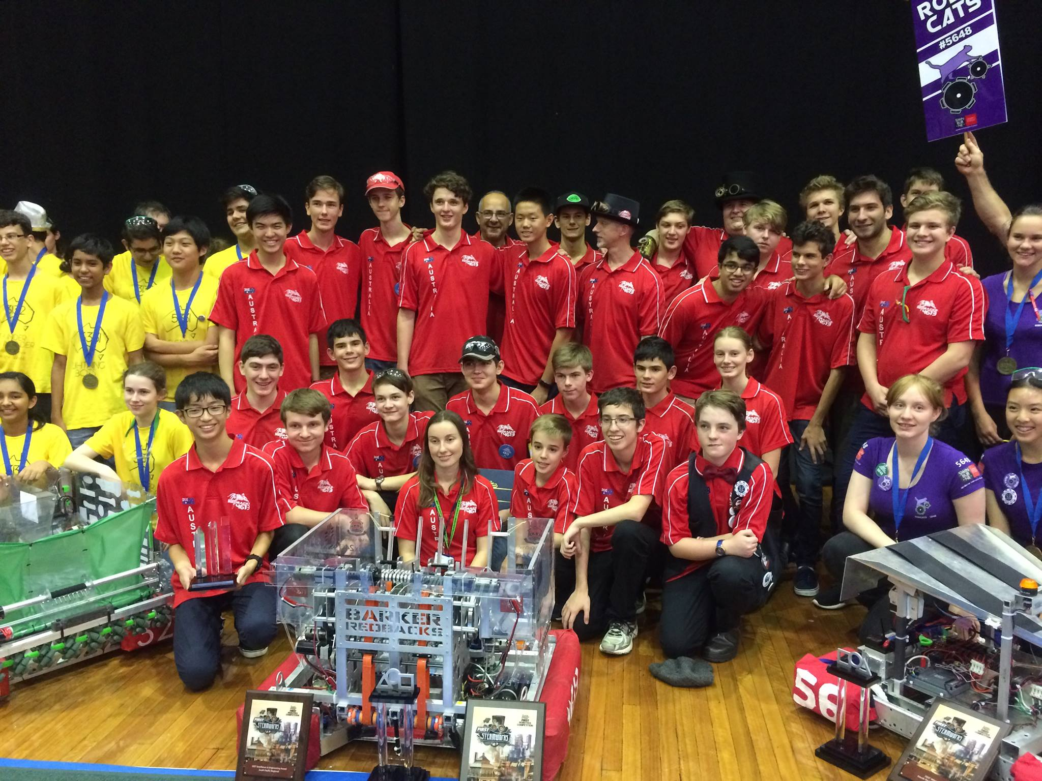
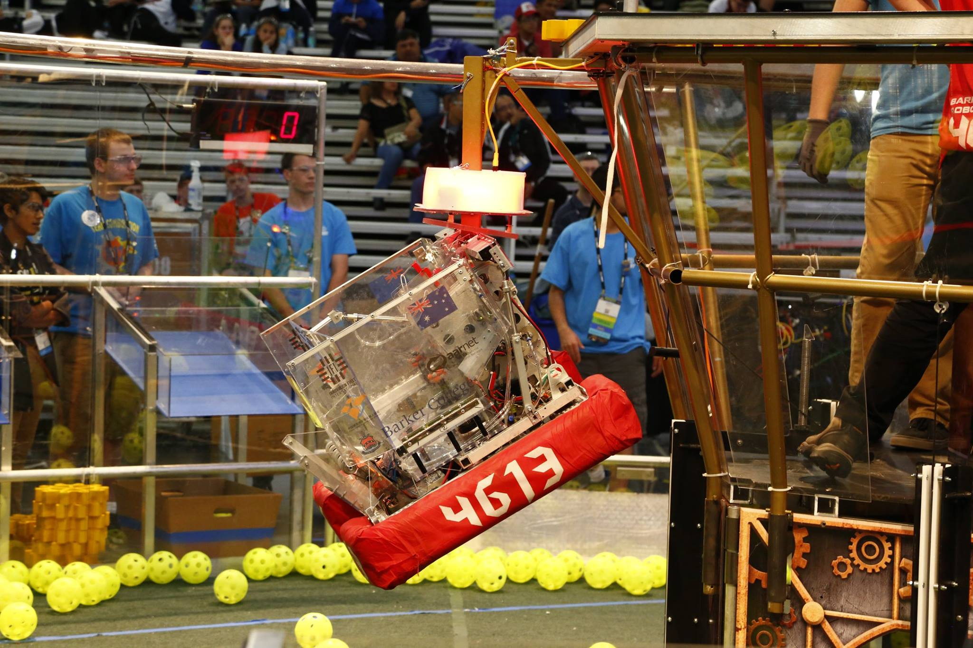
Introduction to (Java) Programming – 2.7 – Functions
Tom Schwarz

Slide 2
Lesson 8: Functions
Functions are helpful and let you repeat the same code several time. For example…
public class Main { _ public static void main(String[] args) { _ printPotato(); //Runs the code inside printPotato _ } _ void printPotato() { _ //Code that gets run by printPotato goes here System.out.println("Potato.🥔"); _ } _ } _
This code would output "Potato.🥔"
Notice that functions go below the “Class” level, at the same level as “public static void main”
“public static void main” is actually a type of function. It’s a special type of function that is run by Java when the program starts
Notice that, like Variables functions have various keywords that go before it, changing what it does
Note the parenthesis which group’s the lines of code together in the function

Slide 3
Lesson 8: Functions
void printPotato() { _
“printPotato” – this is the name of the function, like a variable
This variable just does the same thing every time. But, we can make variables take some data and change what they do based on that:
public static void printPotato(int bestNumber, int betterNumber) { _ //Code that gets run by printPotato goes here System.out.println(bestNumber + " is the best number. By far."); _ System.out.println(betterNumber + "is a better number."); _ } _
You can take any type of and as many variables as you want

Slide 4
Lesson 8: Functions
Taking data is okay, but what about returning data? Functions can simply code for you and return a value. For example:
static int cube(int numberToCube) { _ return numberToCube*numberToCube*numberToCube; _ } _
Then later in the code…
int num1 = 4; _ int num2 = 839; _ int num1Cubed = cube(num1); _ System.out.println("Number1: " + num1 + " Cubed: " + num1Cubed); System.out.println("Number2: " + num2 + " Cubed: " + cube(num2)); _
Which will produce...
Number1: 4 Cubed: 64 _ Number2: 839 Cubed: 590589719 _

Slide 5
Lesson 8: Functions
You use the return keyword to return a variable from a function
Note the int keyword before the function, which says that the function returns an integer
You can return any variable
You write void for functions that don’t return anything
Note that, the code when it’s executing, like variables, doesn't see a function – it only sees what it returns
Functions can be used in if & while statements
You’ve already used functions before – anything with “()” in it is a function – so println(), Math.sqrt(), etc. are functions

Slide 6
Lesson 8: Functions
Yay! Now you understand what functions are and can be used for!
Now do some of the activites at https://github.com/Team4613-BarkerRedbacks/Programming-Java-Guide/blob/master/2.Core-elements-of-programs/2.7.Functions.md
Activities
Write a function that finds the average of 4 numbers. Use the function to print out the results (NOTE: The function should NOT print out the result.)
Write a function which, given the starting amount, interest rate/year and amount of years returns the final amount of money. You can use the formula "final amount = starting amount * (1+interest rate)years accumulating" to calculate it. (Assume that it compounds yearly.)
Write a function that returns a Boolean, checking if the given number is prime

